Slide 1
Lab 8 – MVVM
Mr. Yousif Garabet Arshak
Computer Science Department
University of Zakho
yousif.arshak@uoz.edu.krd

Slide 2
OUTLINES
MVVM Example

Slide 3
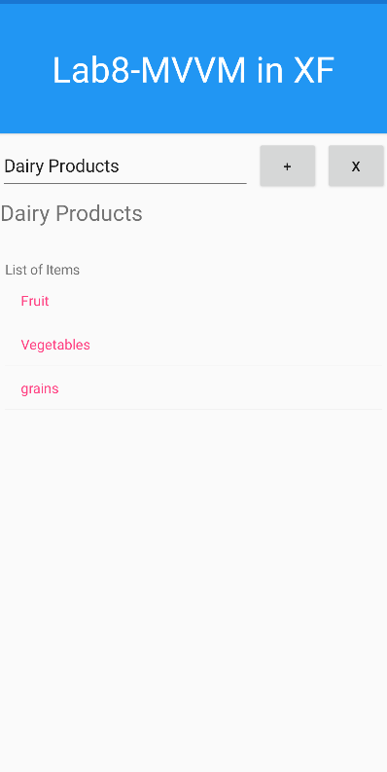
MVVM Example
We are going to create this application using MVVM

Slide 4
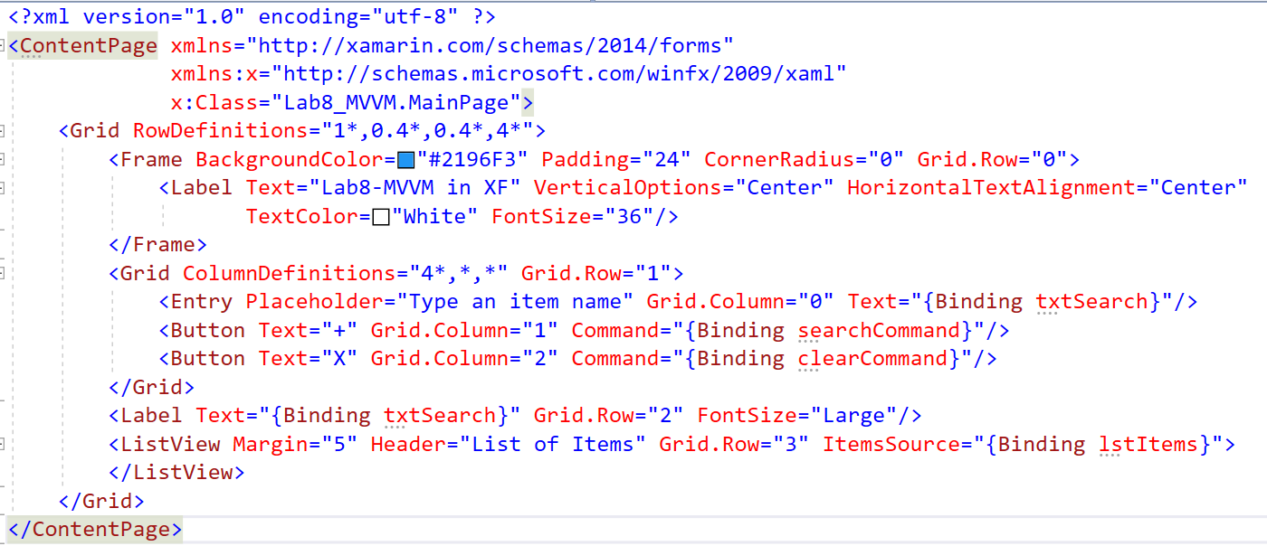
View - Design Application with XAML

Slide 5
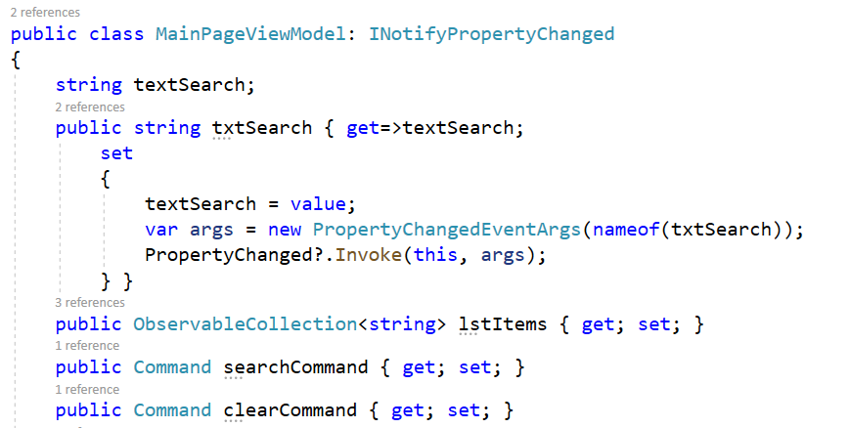
ViewModel – Create viewmodel class

Slide 6
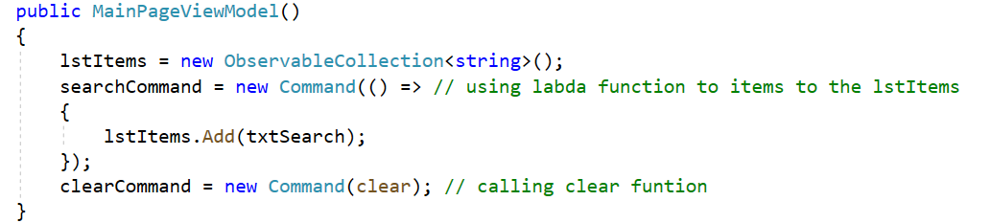
Add Constructor to the viewmodel class

Slide 7
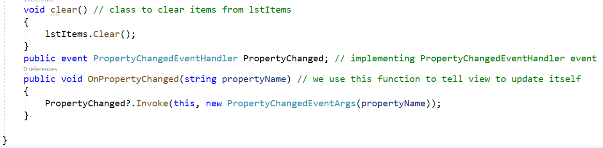
Add function and implement event

Slide 8
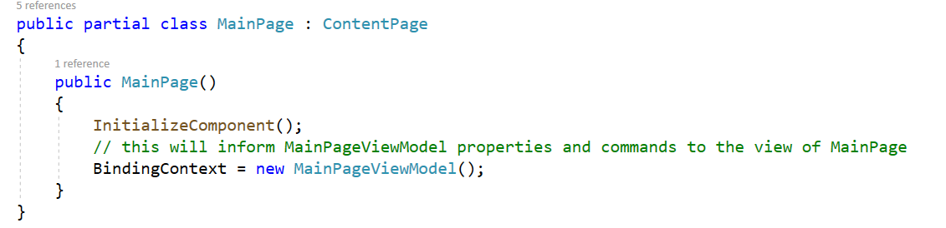
Add our viewmodel to the MainPage

Slide 9
Excercise
Create Fruit app to show list of Fruits and each fruit has (Picture, Name) in listview and add (Add, Delete, Update) items to the listview using SQLite & MVVM

